Slide 1
Advanced Data Analysis - SQL
Products And Customer analysis

Slide 2
INTRODUCTION
The Advanced Data Analysis process will be performed based six different categories as below shown:
1. Change over Time Analysis
2. Cumulative Analysis
3. Performance analysis (Year-Over-Year,Month-Over-Month)
4. Part-to-Whole analysis
5. Data Segmentation Analysis
6. Data Reporting

Slide 3
1.Change Over Time Analysis
Purpose:
- To track trends, growth, and changes in key metrics over time.
- For time-series analysis and identifying seasonality.
- To measure growth or decline over specific periods.
SQL Functions Used:
- Date Functions: DATEPART(), DATETRUNC(), FORMAT()
- Aggregate Functions: SUM(), COUNT(), AVG()

Slide 4
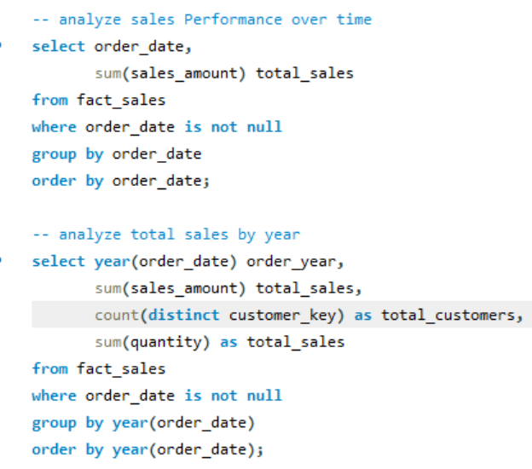
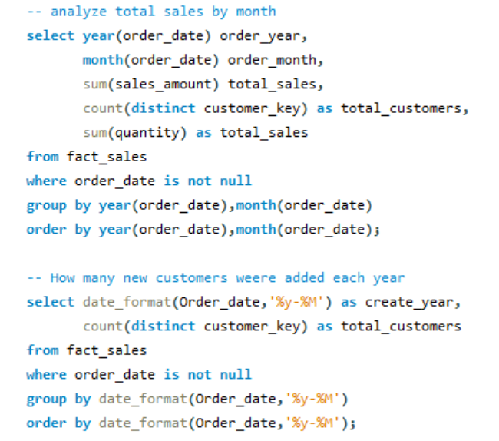

Slide 5
2. Cumulative Analysis
Purpose:
- To calculate running totals or moving averages for key metrics.
- To track performance over time cumulatively.
- Useful for growth analysis or identifying long-term trends.
SQL Functions Used:
- Window Functions: SUM() OVER(), AVG() OVER()
- CTE

Slide 6
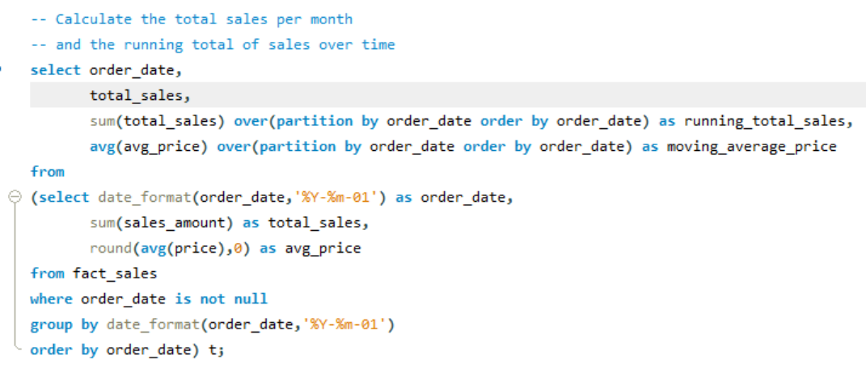
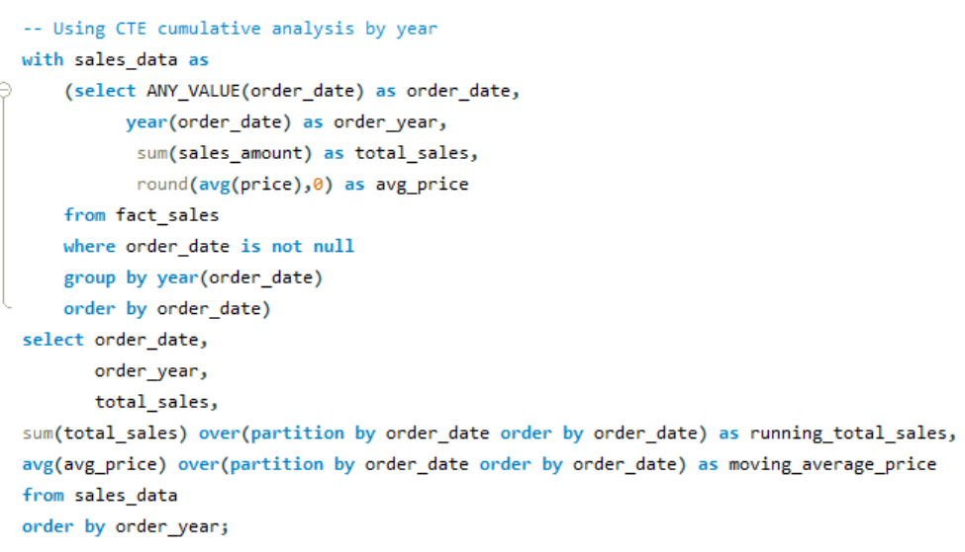

Slide 7
3.Performance Analysis
Purpose:
- To measure the performance of products, customers, or regions over time.
- For benchmarking and identifying high-performing entities.
- To track yearly trends and growth.
SQL Functions Used:
- LAG(): Accesses data from previous rows.
- AVG() OVER(): Computes average values within partitions.
- CASE: Defines conditional logic for trend analysis.

Slide 8
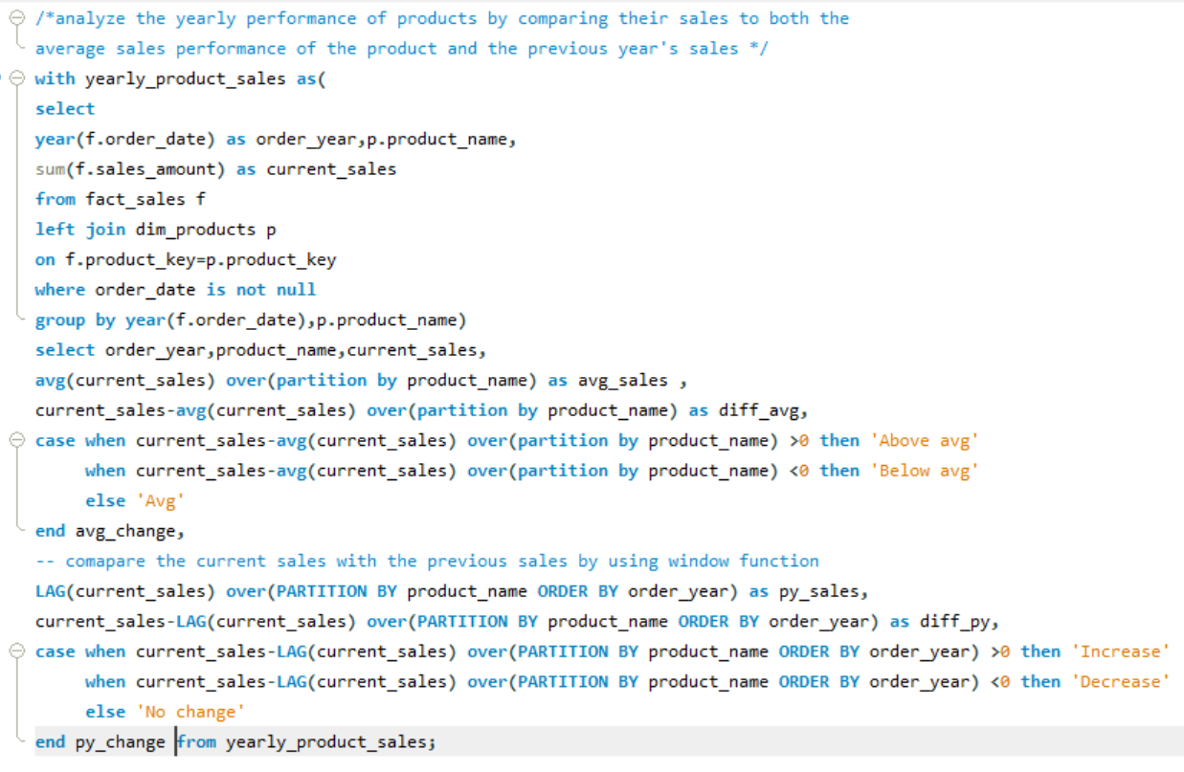

Slide 9
4.Part-To-whole Analysis
Purpose:
- To compare performance or metrics across dimensions or time periods.
- To evaluate differences between categories.
- Useful for A/B testing or regional comparisons.
SQL Functions Used:
- SUM(), AVG(): Aggregates values for comparison.
- Window Functions: SUM() OVER() for total calculations.

Slide 10
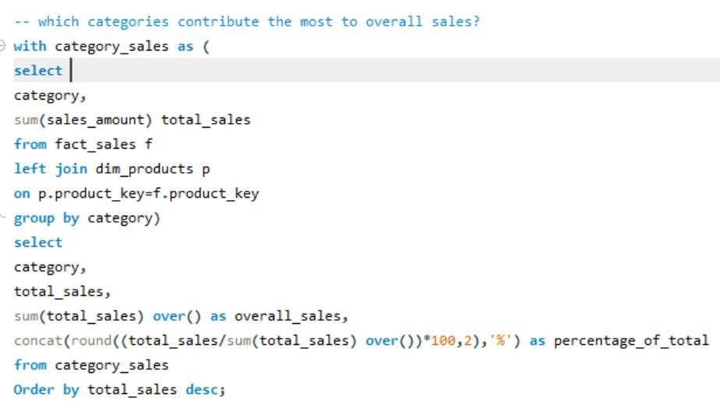

Slide 11
5.Data Segmentation
Purpose:
- To group data into meaningful categories for targeted insights.
- For customer segmentation, product categorization, or regional analysis.
SQL Functions Used:
- CASE: Defines custom segmentation logic.
- GROUP BY: Groups data into segments.

Slide 12
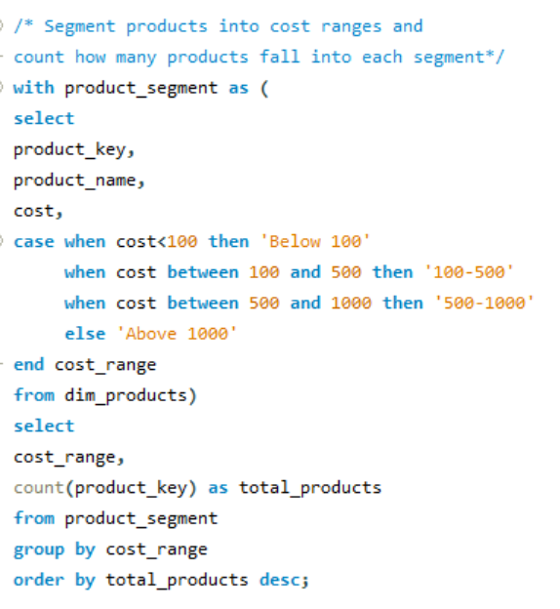

Slide 13
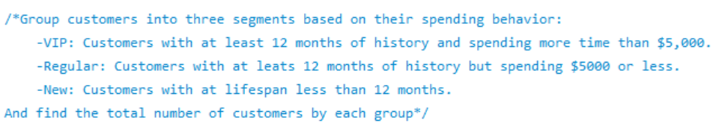
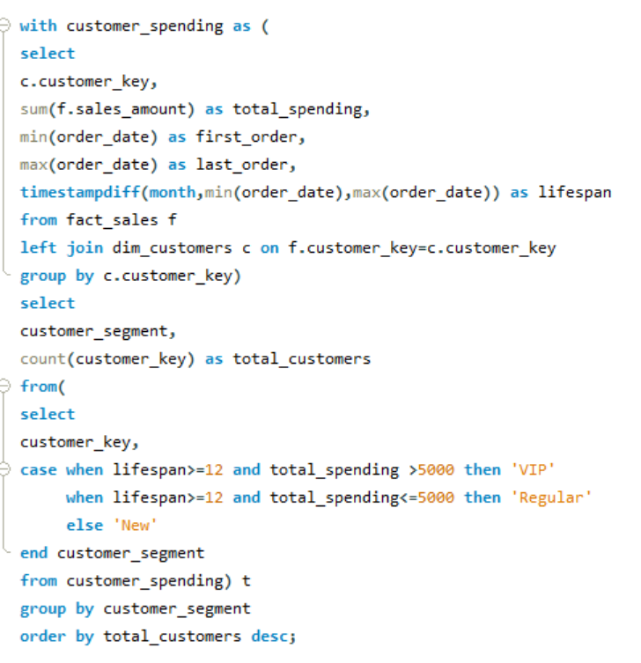

Slide 14
6.Data Reporting
Purpose: ===Customer report===
- This report consolidates key customer metrics and behaviors
Highlights:
1. Gathers essential fields such as names, ages, and transaction details.
2. Segments customers into categories (VIP, Regular, New) and age groups.
3. Aggregates customer-level metrics:
- total orders
- total sales
- total quantity purchased
- total products
- lifespan (in months)
4. Calculates valuable KPIs:
- recency (months since last order)
- average order value
- average monthly spend

Slide 15
Purpose: ===Product Report===
- This report consolidates key product metrics and behaviors.
Highlights:
1. Gathers essential fields such as product name, category, subcategory, and cost.
2. Segments products by revenue to identify High-Performers, Mid-Range, or Low-Performers.
3. Aggregates product-level metrics:
- total orders
- total sales
- total quantity sold
- total customers (unique)
- lifespan (in months)
4. Calculates valuable KPIs:
- recency (months since last sale)
- average order revenue (AOR)
- average monthly revenue

Slide 16
Conclusion
This project demonstrates the power of SQL in Advanced Data Analysis, offering structured insights into customer behaviors and product performance. Through various analytical techniques, it enables businesses to track trends, optimize strategies, and improve decision-making. The segmentation and reporting mechanisms further enhance data-driven decision-making, ensuring that businesses can effectively understand and respond to market dynamics.

Slide 17
Thank You
- SRIVIDYA

